Slide 1
Metric Spike Analysis and Operational Analytics
Sheevam Chakraborty

Slide 2
Project Description:
This project revolves around Operational Analytics, a crucial procedure that comprises an end-to-end examination of business processes and I am the Lead Data Analyst at a company that is similar to Microsoft. Working with cross-functional teams from marketing, operations, and support is crucial to deriving insightful conclusions from the data that has been provided.
The project's primary goal is to investigate metric spikes, or sudden changes in important performance metrics such as sales or daily user engagement. Using your sophisticated SQL knowledge, it is your daily task to interpret and clarify these statistic changes.
Equipped with an array of diverse information and tables, your objective is to address questions from various divisions inside the firm. Your objective is to use extensive data analysis to not only find insights but also to improve overall operational efficiency and understanding of unexpected metric variations. The project in question highlights the essential function of data analytics in guiding operational enhancements and well-informed decision-making in an organisational context.

Slide 3
Approach and Tech Stack used:
Define Metrics and Objectives: - Clearly state the operational goals and metrics that will be the subject of the investigation.
Excel Data Handling: - Extract and clean data in Excel, taking care of outliers and missing values.
Excel-based Initial Analysis: - Make use of Excel for simple exploratory analysis and trend identification by visualising data.
Export to MySQL Workbench: - Fine-tune and export data that has been cleaned to MySQL Workbench for comprehensive examination.
Advanced SQL Analysis with MySQL: - Use MySQL Workbench to analyse SQL in an advanced manner, paying particular attention to spikes in metrics.
Insight Generation: - To obtain actionable insights, integrate results from both MySQL and Excel analysis.
Excel Reporting: - Produce detailed reports with visual aids for effective communication.

Slide 4
INSIGHTS AND ANALYSIS
Case Study 1: Job Data Analysis
Case Study 2: Investigating Metric Spike

Slide 5
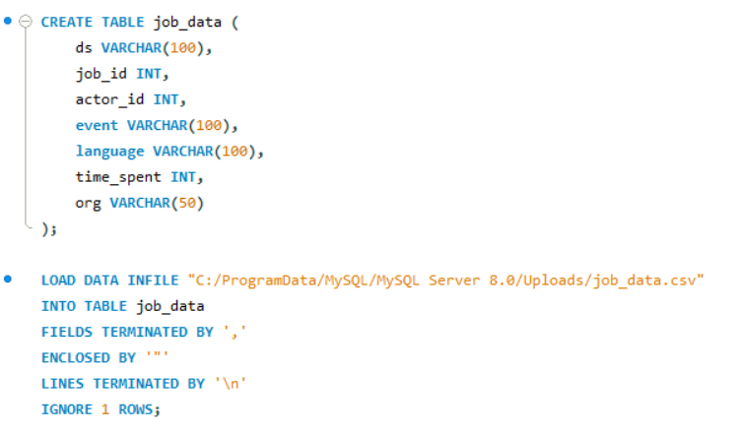
Case Study 1: Job Data Analysis
You will be working with a table named job_data with the following columns:
job_id: Unique identifier of jobs
actor_id: Unique identifier of actor
event: The type of event (decision/skip/transfer).
language: The Language of the content
time_spent: Time spent to review the job in seconds.
org: The Organization of the actor
ds: The date in the format yyyy/mm/dd (stored as text).

Slide 6
Insights required:
Jobs Reviewed Over Time:
Objective: Calculate the number of jobs reviewed per hour for each day in November 2020.
Your Task: Write an SQL query to calculate the number of jobs reviewed per hour for each day in November 2020.
SELECT
COUNT(DISTINCT job_id) / 24 * 30 AS jobs_per_hour_per_day
FROM
job_data
WHERE
ds BETWEEN '2020-11-01' AND '2020-11-30';

Slide 7
B. Throughput Analysis:
Objective: Calculate the 7-day rolling average of throughput (number of events per second).
Your Task: Write an SQL query to calculate the 7-day rolling average of throughput. Additionally, explain whether you prefer using the daily metric or the 7-day rolling average for throughput, and why.
SELECT ds,
jobs_count,
AVG(jobs_count) OVER(ORDER BY ds ROWS BETWEEN 6 PRECEDING AND CURRENT ROW)
as rolling_avg_throughput
FROM
(
SELECT
ds, COUNT(DISTINCT job_id) AS jobs_count
FROM
job_data
WHERE
ds BETWEEN '2020-11-01' AND '2020-11-30'
GROUP BY ds
) temp;

Slide 8
C. Language Share Analysis:
Objective: Calculate the percentage share of each language in the last 30 days.
Your Task: Write an SQL query to calculate the percentage share of each language over the last 30 days
SELECT
language,
ROUND((COUNT(*) / (SELECT
COUNT(*)
FROM
job_data)) * 100,
1) AS percentage_share
FROM
job_data
WHERE
ds BETWEEN '2020-11-01' AND '2020-11-30'
GROUP BY language;

Slide 9
D. Duplicate Rows Detection:
Objective: Identify duplicate rows in the data.
Your Task: Write an SQL query to display duplicate rows from the job_data table.
SELECT *
FROM
(
SELECT *,
ROW_NUMBER() OVER (
PARTITION BY job_id, actor_id, event, language, time_spent, org, ds)
AS row_num
FROM job_data
) temp
WHERE row_num > 1;
“Since there are no duplicates
In our dataset we get none”

Slide 10
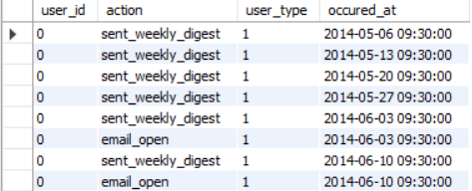
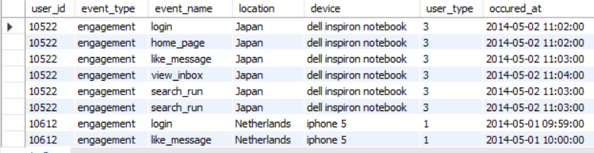
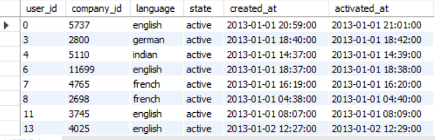
Case Study 2: Investigating Metric Spike
email_events
You will be working with three tables:
users: Contains one row per user, with descriptive information about that user’s account.
events: Contains one row per event, where an event is an action that a user has taken (e.g., login, messaging, search).
email_events: Contains events specific to the sending of emails.
events
users

Slide 11
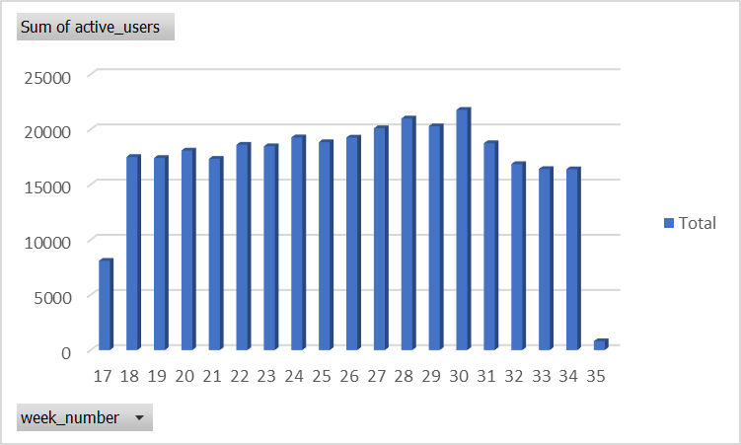
Weekly User Engagement:
Objective: Measure the activeness of users on a weekly basis.
Your Task: Write an SQL query to calculate the weekly user engagement.
SELECT
WEEK(occured_at) AS week_no,
COUNT(user_id) AS active_users
FROM
events
GROUP BY week_no;
“Most user activity was recorded during the weeks 28 - 30 in 2014”

Slide 12
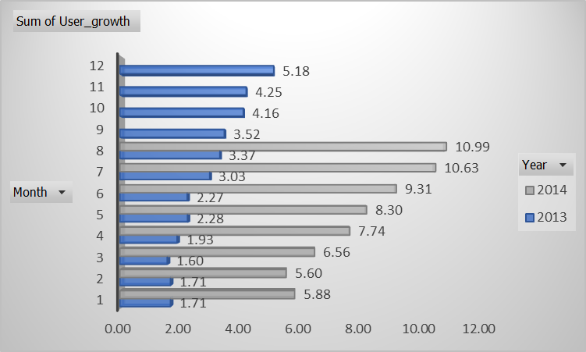
B. User Growth Analysis:
Objective: Analyze the growth of users over time for a product.
Your Task: Write an SQL query to calculate the user growth for the product.
SELECT
YEAR(created_at) AS years,
MONTH(created_at) AS months,
COUNT(DISTINCT user_id) / (SELECT
COUNT(DISTINCT user_id)
FROM
users) * 100 AS user_growth_rate
FROM
users
GROUP BY 1 , 2;
“We can see exponential user growth
in 2014 than 2013.
The best months being July and August”

Slide 13
C. Weekly Retention Analysis:
Objective: Analyze the retention of users on a weekly basis after signing up for a product.
Your Task: Write an SQL query to calculate the weekly retention of users based on their sign-up cohort.
SELECT
WEEK(ACTIVATED_AT) AS weekday_activity,
(COUNT(USER_ID) / (SELECT
COUNT(DISTINCT USER_ID)
FROM
USERS)) * 100 AS weekly_retention_users
FROM
USERS
GROUP BY weekday_activity;
“There’s a massive dip in user retention
between week 33 and 36.”

Slide 14
D. Weekly Engagement Per Device:
Objective: Measure the activeness of users on a weekly basis per device.
Your Task: Write an SQL query to calculate the weekly engagement per device.
SELECT
EXTRACT(WEEK FROM occured_at) AS week_no,
device,
COUNT(DISTINCT user_id) AS users
FROM
events
WHERE
event_type = 'engagement'
GROUP BY week_no, device;
“MacBook pro has the highest user engagement per week (4900+)”

Slide 15
E. Email Engagement Analysis:
Objective: Analyze how users are engaging with the email service.
Your Task: Write an SQL query to calculate the email engagement metrics.
SELECT
SUM(CASE WHEN ea = 'click' THEN 1 ELSE 0 END) /
SUM(CASE WHEN ea = 'sent' THEN 1 ELSE 0 END)
* 100 AS click_through_rate,
SUM(CASE WHEN ea = 'open' THEN 1 ELSE 0 END) /
SUM(CASE WHEN ea = 'sent' THEN 1 ELSE 0 END)
* 100 AS open_rate,
SUM(CASE WHEN ea = 'click' THEN 1 ELSE 0 END) /
SUM(CASE WHEN ea = 'open' THEN 1 ELSE 0 END)
* 100 AS click_to_open_rate
FROM
(SELECT
*,
CASE
WHEN action IN ('email_clickthrough') THEN 'click'
WHEN action IN ('email_open') THEN 'open'
WHEN action IN ('sent_reengagement_email' ,
'sent_weekly_digest') THEN 'sent'
END AS ea
FROM
email_events) a;
“The click to open ratio among users
Is at a record high value”

Slide 16
Reference
Case Study 1: Job Data Analysis Query link:
https://drive.google.com/file/d/1YKpAGB1RzmwsYBezwGhivtJOsHGMSNYg/view?usp=sharing
Case Study 2: Investigating Metric Spike Query link:
https://drive.google.com/file/d/1eBA1ooTAXPXGHRJh3cek8fLtORbSCi8j/view?usp=sharing

Slide 17
Results
It has been a great experience playing the role of a data analyst and deriving
insights and metrics for a company like Microsoft.
Practical implementation of taught concepts in SQL and Data Analytics were
thoroughly put to test here.
I also tried my best to leverage the usage of excel pivots and charts to draw out
clean ideas for people from a business perspective to grasp and understand.
Look forward to putting these learnings to better use in the coming days.

Slide 18
Thank you!

